Slide 1

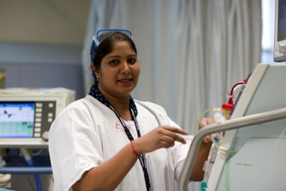

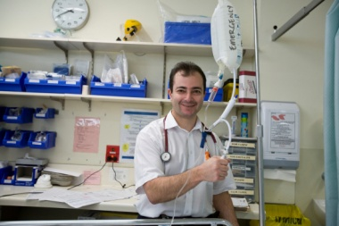
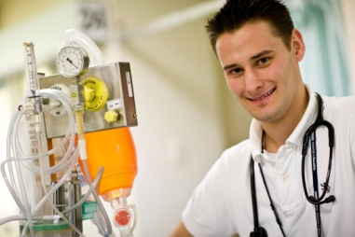

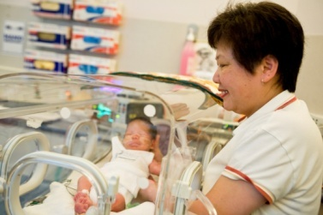
The 2019 VDDI Forum
St. Vincent`s Hospital Melbourne
A Workshop presented by the
Eastern Dual Diagnosis Consumer & Carer Advisory Council
Working Together ‘In-Tandem’

Slide 2
Acknowledgement of Country
We respectfully acknowledge the traditional custodians of the land on which we meet today, the Wurundjeri people of the Kulin Nation, and we pay respects to all Aboriginal elders, past and present.
We recognise and value the knowledge and wisdom of people with a lived experience of mental ill health, their families, supporters and the practitioners who work with them.
We celebrate their strengths and resilience in facing the challenges associated with their recovery and values their important role in the development and delivery of health and community services.

Slide 3
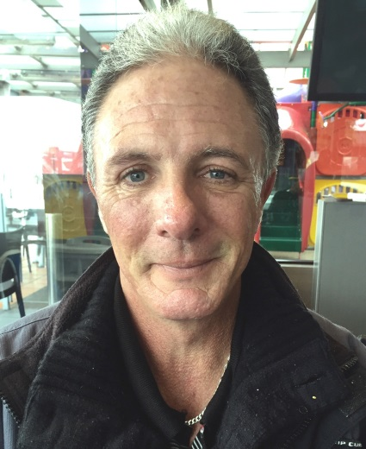
Our ‘In-Tandem Model’ by Fred Murray
The Consumer and Carer Advisory
Council was set up in 2010 by the
Eastern Dual Diagnosis Team to
include the voice of lived-experience
consumers and carers
The Council sits side by side with the Mental Health Working Group in a range of dual diagnosis activities
We call this our In-Tandem Model
Fred Murray

Slide 4

Our Values
1 | Shared Expertise Practitioners/clinicians, consumer and carers all bring expertise
2 | Experience Health services need the consumer and carer experience if they want to improve
3 | Learning Together Being brave enough to learn together

Slide 5
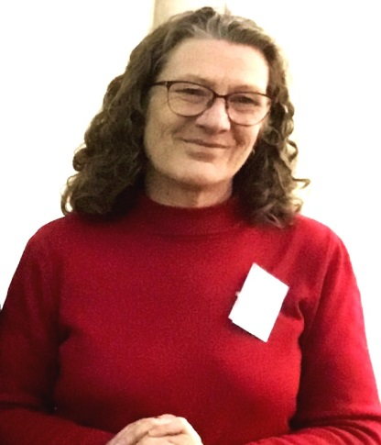
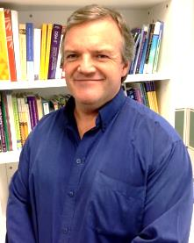
Shared Decision Making…
9 years on and going strong.....
The DDCCAC | The MH Working Group
Gavin Foster
WG Chairperson
Paula Kelly
Council Chairperson
DDCCAC chairperson 8 Lived-experience peers 2 Carers Group Programme leaders Forum presentations Regular reflective practice | Working Group chairperson Dual diagnosis team MHCSS reps AOD service reps Clinical mental health Mentoring

Slide 6
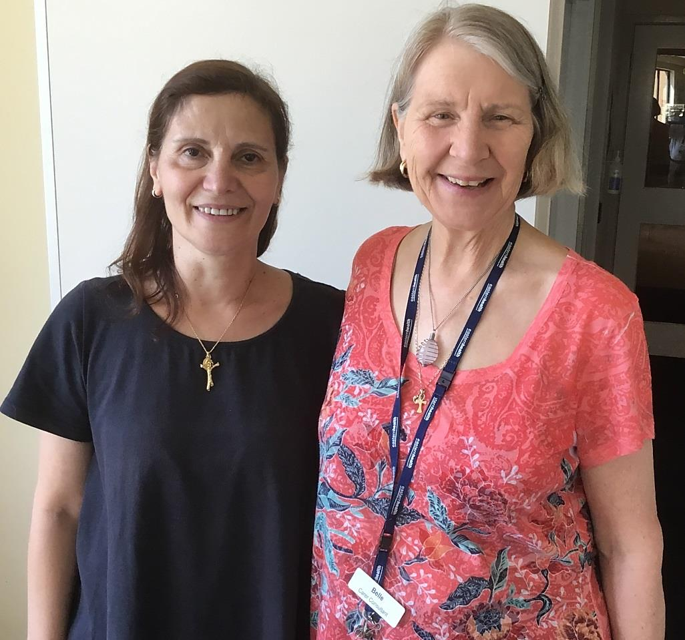
Changing Roles
Belle Groves and Denise Damouni
Denise and Belle - carer members of the Consumer and Carer Advisory Council

Slide 7
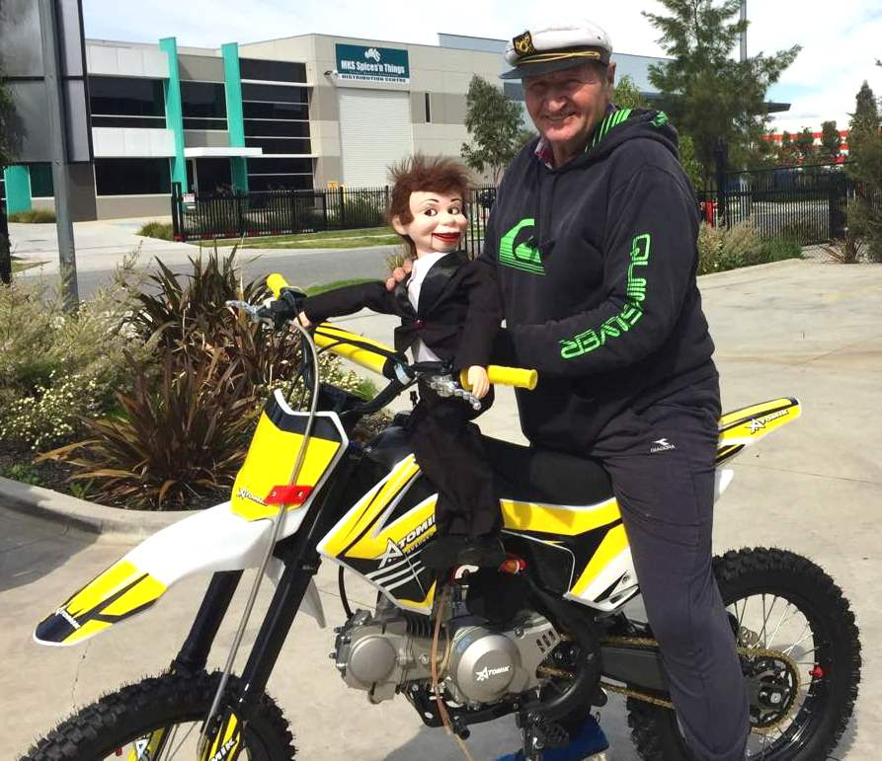
Tony Ryan – Peer Group leader
Tony with Ronnie the talking Puppet (Recovery Assistant!)

Slide 8
Tony Ryan – Peer Group leader
From the age of 21 I got tangled up in addiction to drugs and alcohol. There was plenty of good reasons to stop but I didn`t know how. I was a long way from starting my own recovery.
Co-leading group discussions at the Maroondah Inpatient Unit is my commitment to support our group members while they are on their own recovery pathway
This is possible because of my own recovery journey and as a member of the Council since 2010 has given me a boost in confidence and a clear sense of purpose

Slide 9
Tony Ryan
With the support of AA , my GP and a few hard lessons I stopped all my substance use. I`m much happier for it
Even after about 30years of being clean, I was still on my recovery journey when I got cured of Hep C with a new treatment that I was offered a couple of year ago.
It doesn`t matter how old you are – recovery is possible
When I visit my elderly mother in her rest home I take my Puppet Ronnie.
The residents smile and some even talk to Ronnie – who talks back!

Slide 10

Paula Kelly – CCAC Chairperson
Working In-Tandem – together at the same time

Slide 11
Using the In Tandem Model
the Council has
Developed
Terms of Reference.
Strategic Plan.
A Code of Ethics.
Resource folders for peer facilitators.
Continued to facilitate six peer lead groups across Eastern Health sites

Slide 12
The Group Programme
The Peer-led Group Programme
A typical weekly roster
Service | Peer Leaders | Time
Maroondah IPU 1& 2 | Tony and Paula | Wed 1-2 pm
Wellington House Detox Unit | Fred and Denise | Thurs 10.30 -11.30
Chandler House CMHC | Russell | Tues 11- 12 md
Maroondah CCU | Russell and Rose | Tues 2.15-3.15 pm
Maroondah PARC | Leonie and Rose | Wed 12.30 -1.30pm
Upton House Inpatient Unit | Catherine and Denise | Friday x 1hour
Notes:
Workshop starts 130pm
1.30 to 1.35pm -Gavin's introduction and history
1.35 to 1.40 – Paula
1.40 to 1.45 - Fred
1.45 to 1.50 – Belle

Slide 13
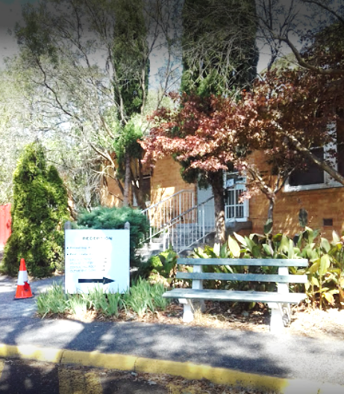
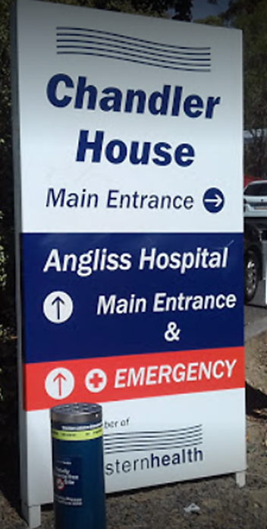
Chandler House Community Mental Health Centre Russell The Tuesday Club 11.00-12.00

Slide 14
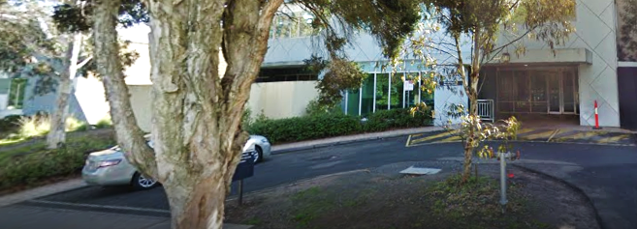
Maroondah Hospital Inpatient Unit 1& 2
Paula and Tony Wednesday 1.00-2.00pm

Slide 15
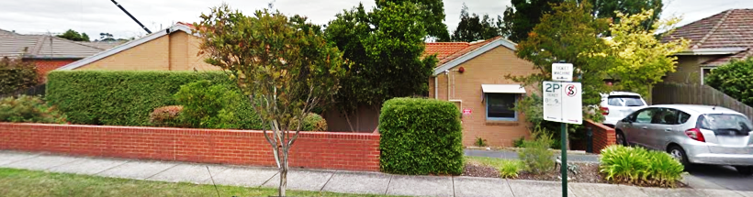
Wellington House Detox Unit
Denise and Fred Thursday 10.30-11.30am

Slide 16
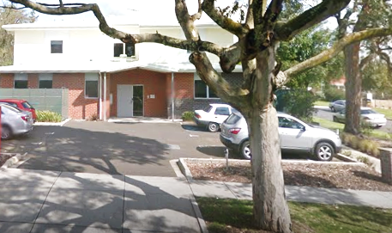
Maroondah Prevention and
Recovery Centre(PARC)
Leonie and Rose Wednesday 12.30-1.30pm

Slide 17
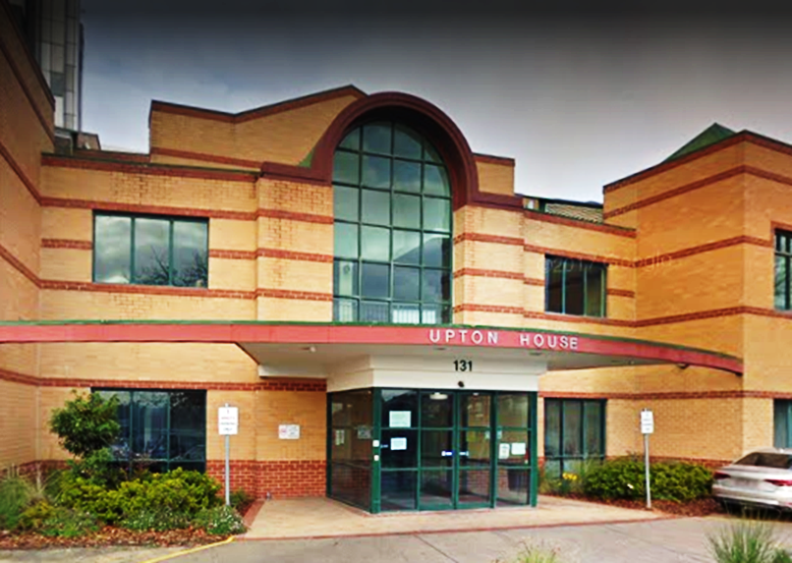
Upton House Inpatient Unit
Catherine and Rose Friday 1.00-2.00pm
Box Hill Hospital

Slide 18
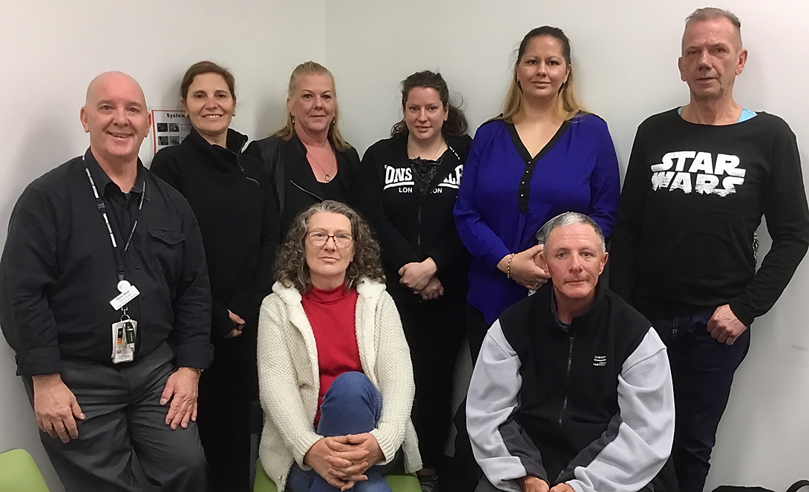
The Dual Diagnosis Consumer and Carer
Advisory Council 2019
Steve West EDDS, Denise Damouni, Catherine White, Rose Parker, Russell Chilcott
Paula Kelly and Fred Murray (Absent Tony Ryan)

Slide 19
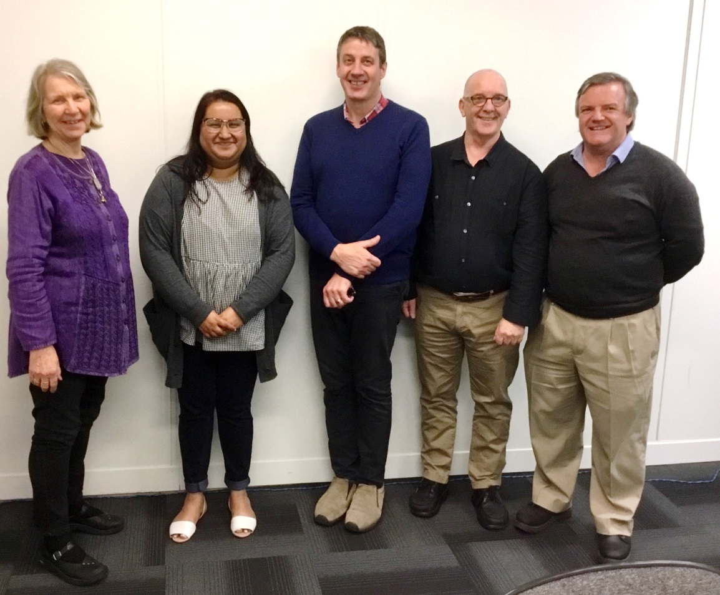
The Dual Diagnosis Consumer and Carer Advisory Council, Working Group 2019
Belle Groves, Shilpa Ullagaddi, Peter Fairbanks Steve West and Gavin Foster
(absent Rob Watson)

Slide 20
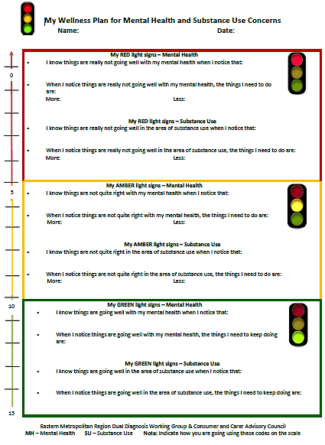
The Traffic Lights Wellness Plan
The ‘Traffic Lights Wellness Plan’ – developed by the DDCCAC and the DDWG as a tool for consumers and their MH/AOD workers

Slide 21
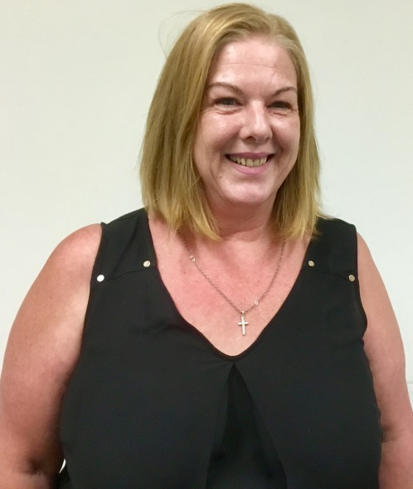

Catherine White supported by her Mentor, Michelle Hegarty
Catherine White
Mentoring for CCAC Peers

Slide 22
Mentor meaning -
An experienced and trusted adviser
“Words are powerful and at times we can have different interpretations for a word and that can have a profound impact in relationship communications”
Establishing a mutual
understanding and intention

Slide 23
Important Relationship
What’s Involved?
Consumer and Carer Council member’s are paired with a ‘Mentor’.
Michelle and I initially met and explored what we both hoped to bring to the relationship and also what we hoped to take away from it.
A safe space to reflect on and encapsulate the role of a Peer Worker.
The Mentor provides guidance through coaching and role modelling effective problem solving
Peer work in Action
The ‘In-Tandem’ model in Action

Slide 24
Practice Development
Professional
Group programme facilitation skills development
How to manage the unexpected in groups
Using open questions and reflective listening (as core skills taken from Motivational Interviewing)
Narrowing the focus of group discussions
Broadening the focus of group discussions
What to do if group members become disruptive
How can I expand my influence as a peer working with health and social services?
Personal
Emotional support
Self – care
Self – disclosure
Relapse prevention
The skills required to facilitate groups in a clinical environment from a peer aspect are practiced within one on one mentoring sessions.

Slide 25

Your questions or comments are welcome
We welcome your enquiries that can be directed to:
Belle Groves, Dual Diagnosis Carer Worker belle.groves@easterhealth.org.au
or
Steve West, Eastern Dual Diagnosis Service
steve.west@easternhealth.org.au

Slide 26
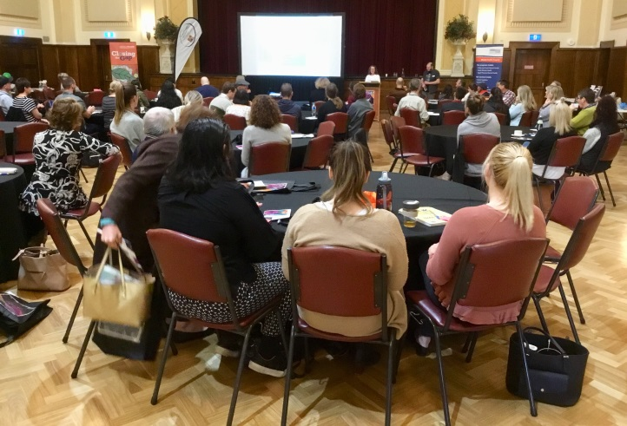
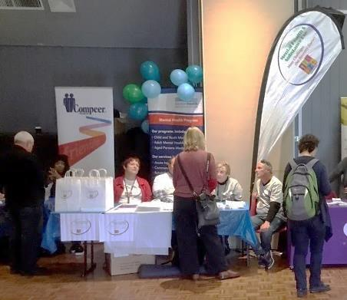
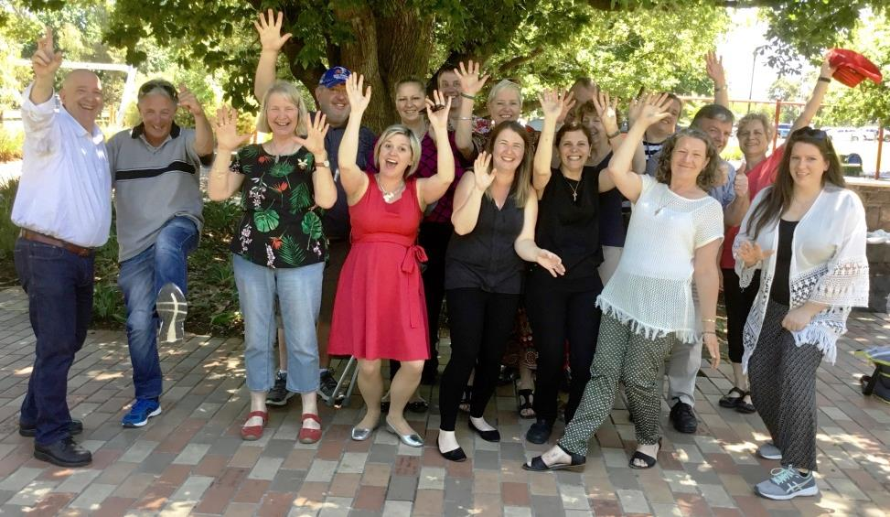
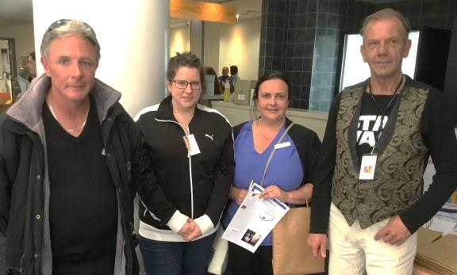
Some activities
Information table at
Mental Health Week 2016
Peer Effect Forum 2018
BUDDYS Youth Dual Diagnosis Expo 2017
End of Year celebration / BBQ at Halliday Park Mitcham

Slide 27
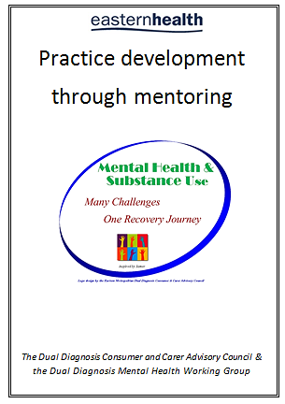
Mentoring Guide

Slide 28
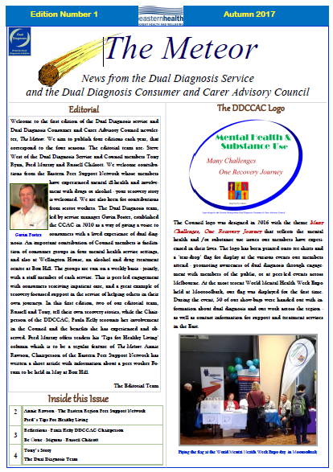
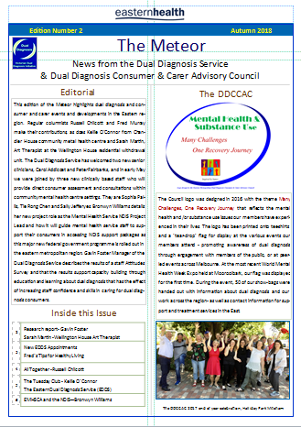
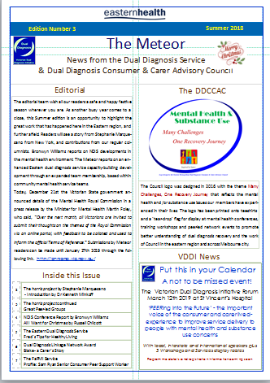
Our Newsletter – The Meteor

